Slide 1
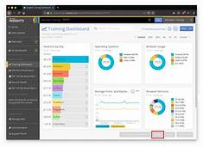


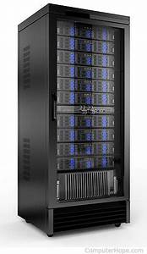
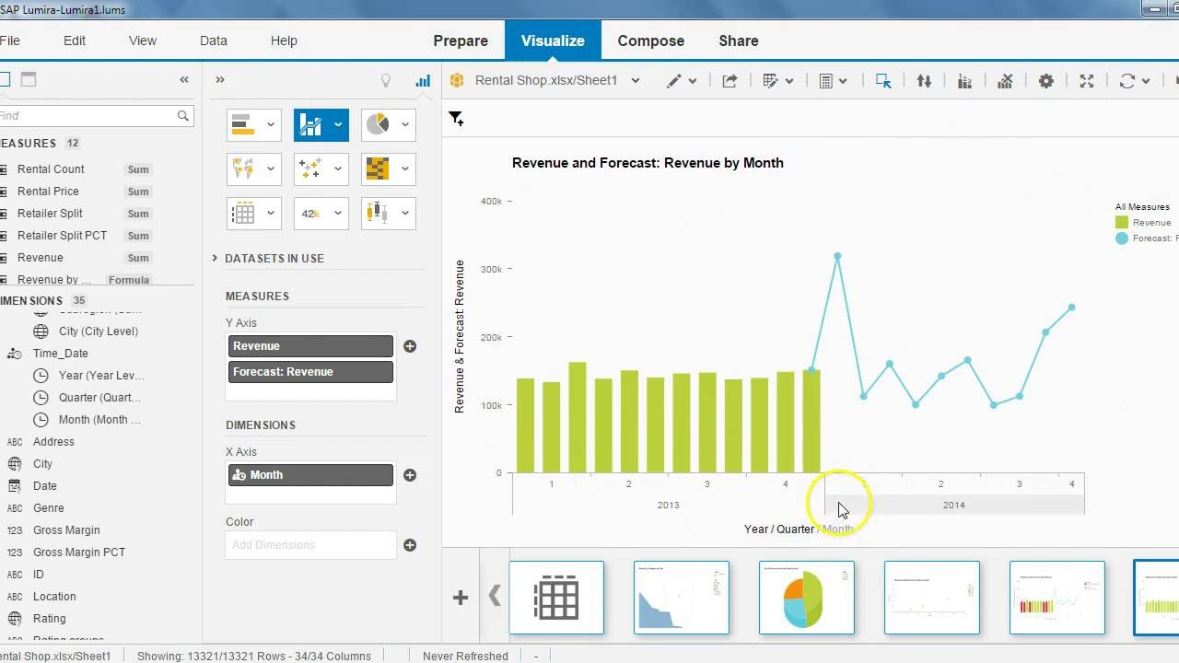

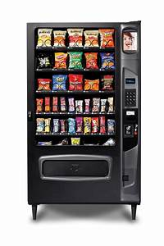
Cloud (Storage and sharing of data)
Dashboard (Displays live data)
External Database (Stores historical data)
Data Integration (Extraction of relevant data)
Data Visualization Predictive Analytics (Displays historical data and predicts future data)
Data Warehouse (Constructing the cube)
Local Database (Stores live data)
Server

